Slide 1


Vishwa Vishwani Institute of Systems & Management
Affiliated to Osmania University
Thumkunta, Hyderabad.
BS-MS (Computer Science) – 5 yrs Integrated
AI POWERED SAST AGENT
Sai Sanjana Gujjari 217022026028
Dumpala Pardha Saradhi 217022026007
Ms. Roshini
Assistant Professor
Department of BS-MS (CS)

Slide 2
Introduction
Traditional SAST tools depend on curated rule libraries — verbose output, high false positives, no fix guidance.
AI Powered SAST Agent is a full-stack web platform where Large Language Models act as the scanning engine, reading source code directly.
A developer submits a GitHub URL or ZIP; each file is analysed by a fault-tolerant multi-provider LLM pipeline.
Every finding carries severity, exact line numbers, CWE/OWASP mapping, plain-English explanation, a proof-of-concept, and a ready-to-apply fix.
Results stream live to a React dashboard over Server-Sent Events.

Slide 3
Problem Statement
Rule-based scanners (SonarQube, Semgrep, Checkmarx) miss context-dependent and logic-level vulnerabilities.
Their output — rule IDs and line numbers — says nothing about exploitability, business impact, or remediation.
High false-positive noise causes developers to ignore genuine findings (alert fatigue).
Security incidents cost the global economy an estimated USD 8 trillion in 2023, much of it from preventable code weaknesses.
Need: tooling that detects, explains, and helps fix issues across many languages.

Slide 4
Existing System & Limitations
Existing systems: SonarQube, Semgrep, Checkmarx — signature / rule-based static analysers that match code against curated pattern libraries.
Limitations:
Manual rule maintenance for every language and vulnerability class.
High false-positive rate leading to alert fatigue.
No contextual explanation, impact analysis, or fix guidance.
Weak on logic-level and context-dependent flaws.
Separate tools needed for scanning, reporting and remediation.

Slide 5
Proposed System & Objectives
LLM-native scanning: models read and reason over source code, backed by a fault-tolerant multi-provider pipeline — NVIDIA NIM (Llama 3.1) to Google Gemini 1.5 Flash to OpenAI GPT-4o-mini.
Objectives
Detect vulnerabilities through semantic LLM analysis across 11+ languages.
Enrich each issue with explanation, impact, proof-of-concept, remediation and fix code.
Map findings to CWE / OWASP and assign severity and a weighted risk score.
Stream live scan progress to the dashboard via Server-Sent Events.
Provide a transparent, developer-friendly alternative to rule engines.

Slide 6
Scope & Modules
Web-based platform; source supplied as a GitHub repository URL or ZIP upload.
Languages: JavaScript, TypeScript, Python, Go, Java, PHP, Ruby, C/C++.
Five modules: Authentication, Projects & Scans, AI Scanner, Issues & AI Enrichment, Frontend Dashboard.
Asynchronous scan pipeline using a Bull queue on Redis; findings persisted in PostgreSQL.
Containerised deployment via Docker Compose with an Nginx reverse proxy.

Slide 7
Feasibility Study
Technical: proven stack (Node.js, React, PostgreSQL, Redis); LLM APIs accessible; multi-provider fallback ensures reliability.
Economic: open-source stack, pay-per-use LLM APIs, runs on 4 GB RAM — no licensed scanner required.
Operational: simple web UI, GitHub login, no client install; fits existing developer workflow.
Legal: uses licensed AI APIs within terms; code processed transiently; all libraries open-source.
Schedule: modular milestones delivered within the academic timeline.

Slide 8
Requirements Specification
Functional Requirements
GitHub OAuth login; submit scan via URL or ZIP; live status; AI-enriched reports; dashboard & history.
Non-Functional Requirements
Security (Helmet, CORS, rate-limiting, Zod); reliability via provider fallback; scalability via queue; usability.
Software Requirements
Node.js 20, React 18, PostgreSQL 15, Redis 7, Docker, Nginx, Prisma, Bull.
Hardware Requirements
Processor : Dual-core 2.0 GHz or higher
Hard disk : 20 GB minimum
RAM : 4 GB minimum (8 GB recommended)

Slide 9
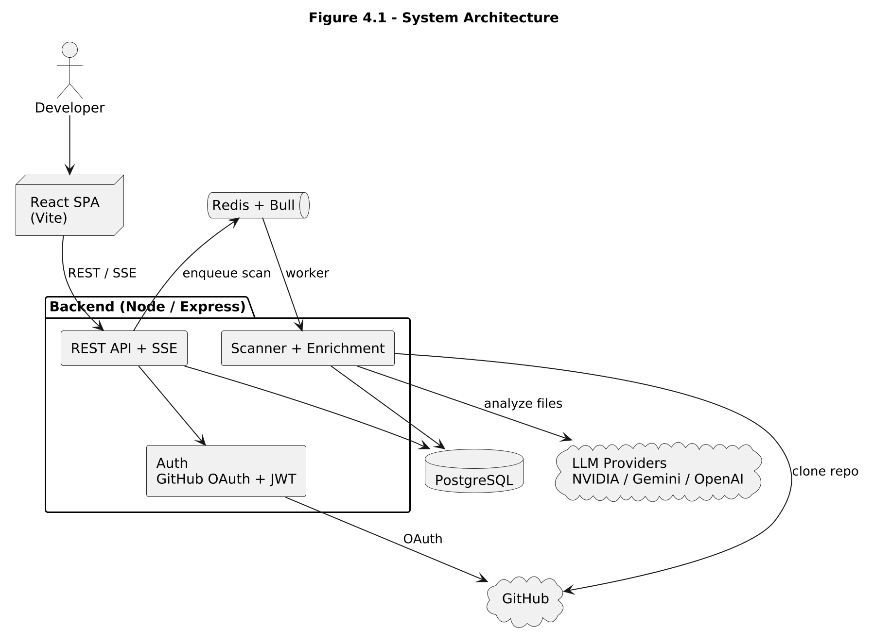
System Architecture (Diagram)

Slide 10
Modules
Module 1 — Authentication: GitHub OAuth 2.0 with a JWT stored as an HttpOnly cookie.
Module 2 — Projects & Scans: scan submission, Bull queue dispatch, 7-state lifecycle tracking.
Module 3 — AI Scanner: walks source files; multi-provider LLM chain (NVIDIA → Gemini → OpenAI); structured JSON findings.
Module 4 — Issues & AI Enrichment: adds explanation, impact, PoC, remediation and fix code per issue.
Module 5 — Frontend Dashboard: React/Vite — Dashboard, New Scan, Results, History, Projects.

Slide 11
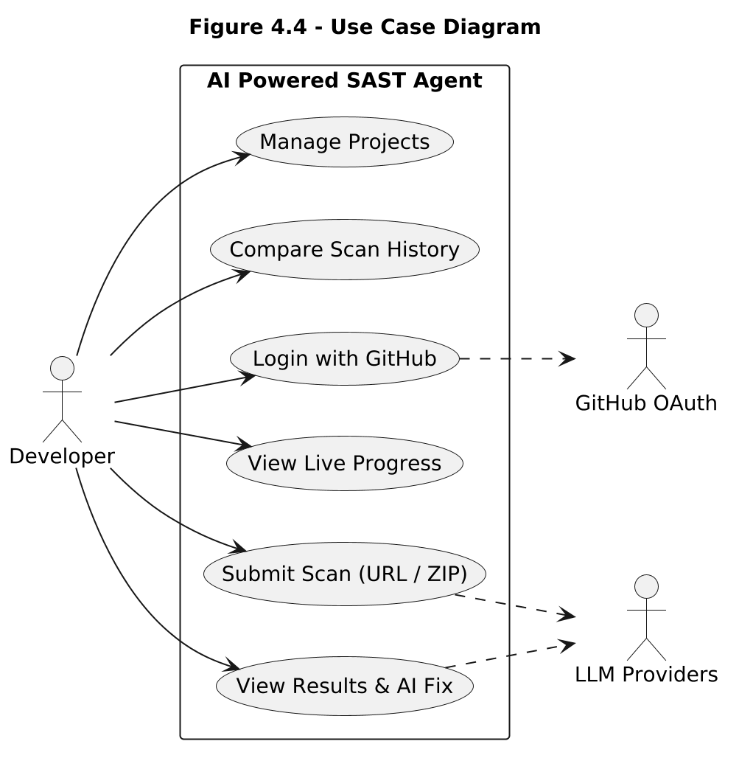
UML Diagrams
Usecase Diagram:

Slide 12
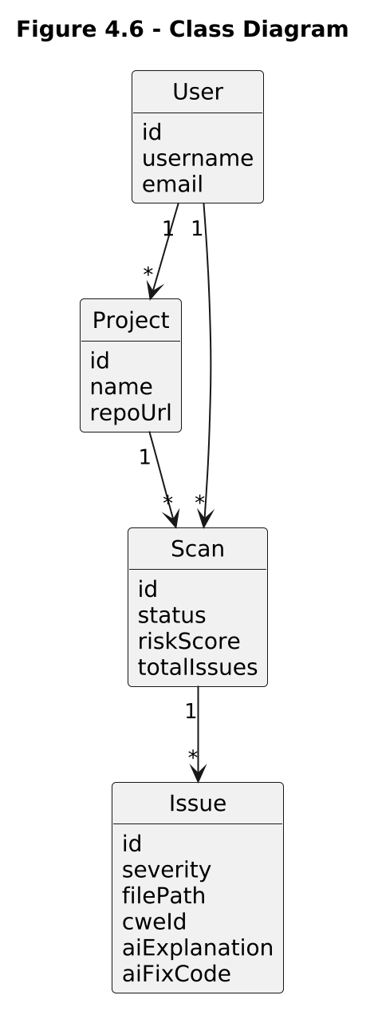
UML Diagrams
Class Diagram:

Slide 13
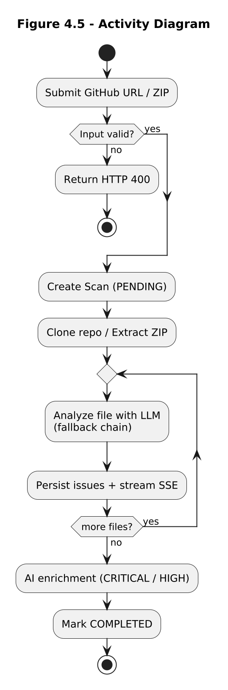
UML Diagrams
Activity Diagram:

Slide 14
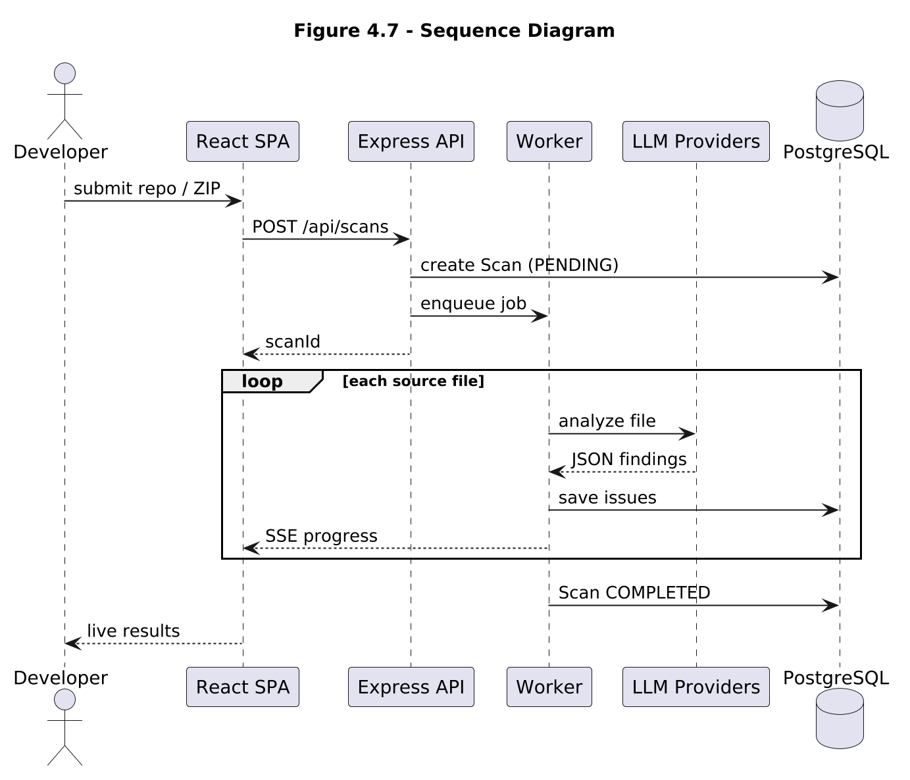
UML Diagrams
Sequence Diagram:

Slide 15
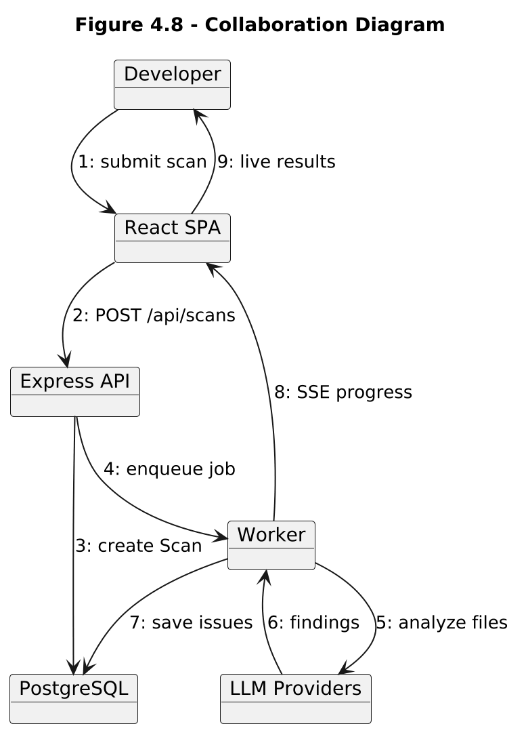
UML Diagrams
Collaboration Diagram:

Slide 16
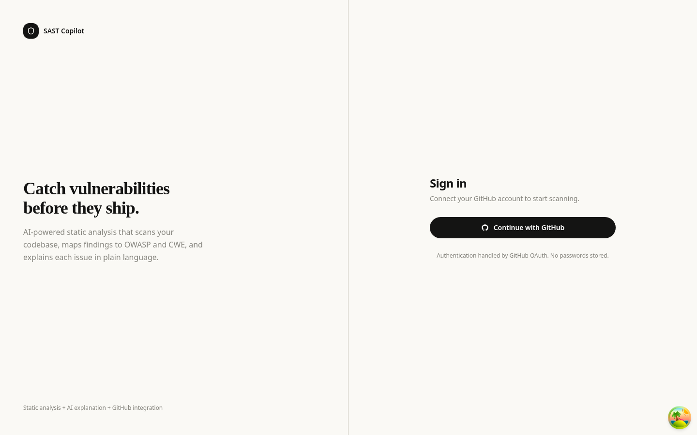
Results
Test Case 1 — GitHub OAuth Login
Action: click "Login with GitHub" and authorise.
Expected: JWT cookie set, user redirected to dashboard.
Result: login successful — session established.
Result Screen

Slide 17
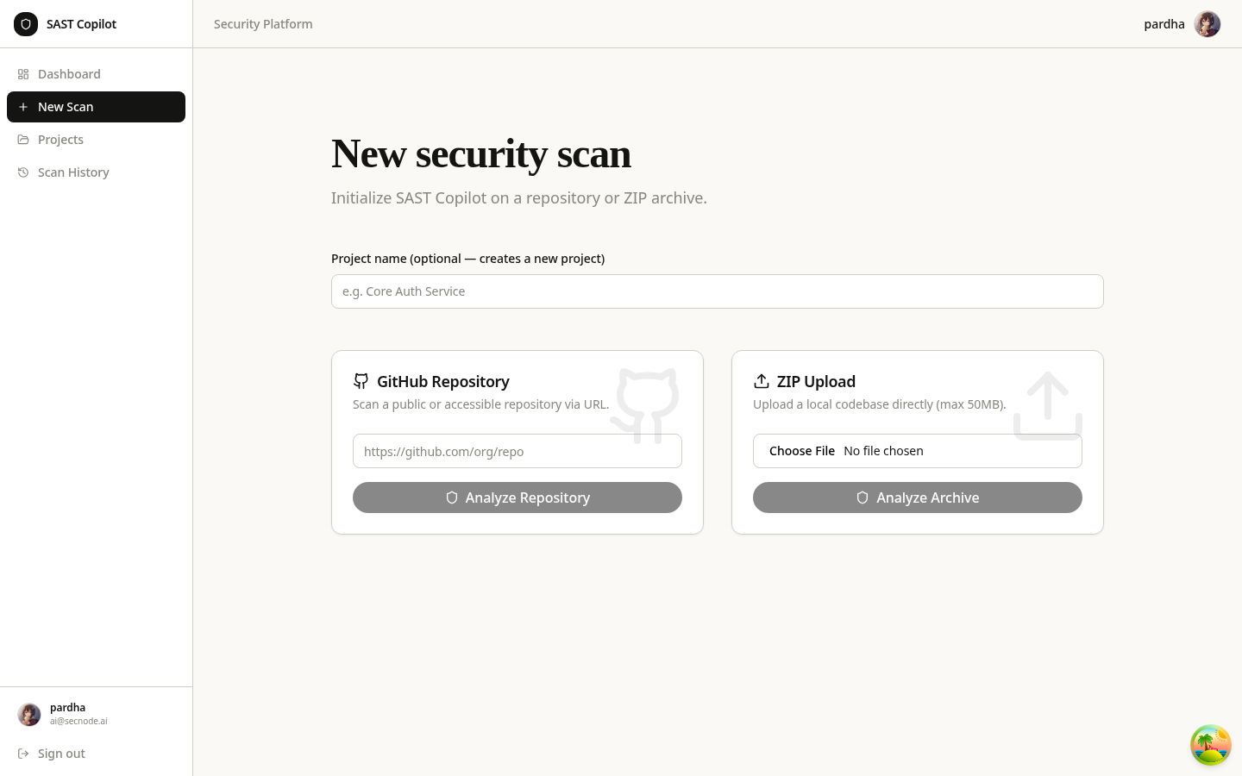
Results
Test Case 2 — New Scan Submission
Action: submit a GitHub repo URL / ZIP upload.
Expected: scan job queued, status PENDING → SCANNING.
Result: scan created and dispatched to worker.
Result Screen

Slide 18
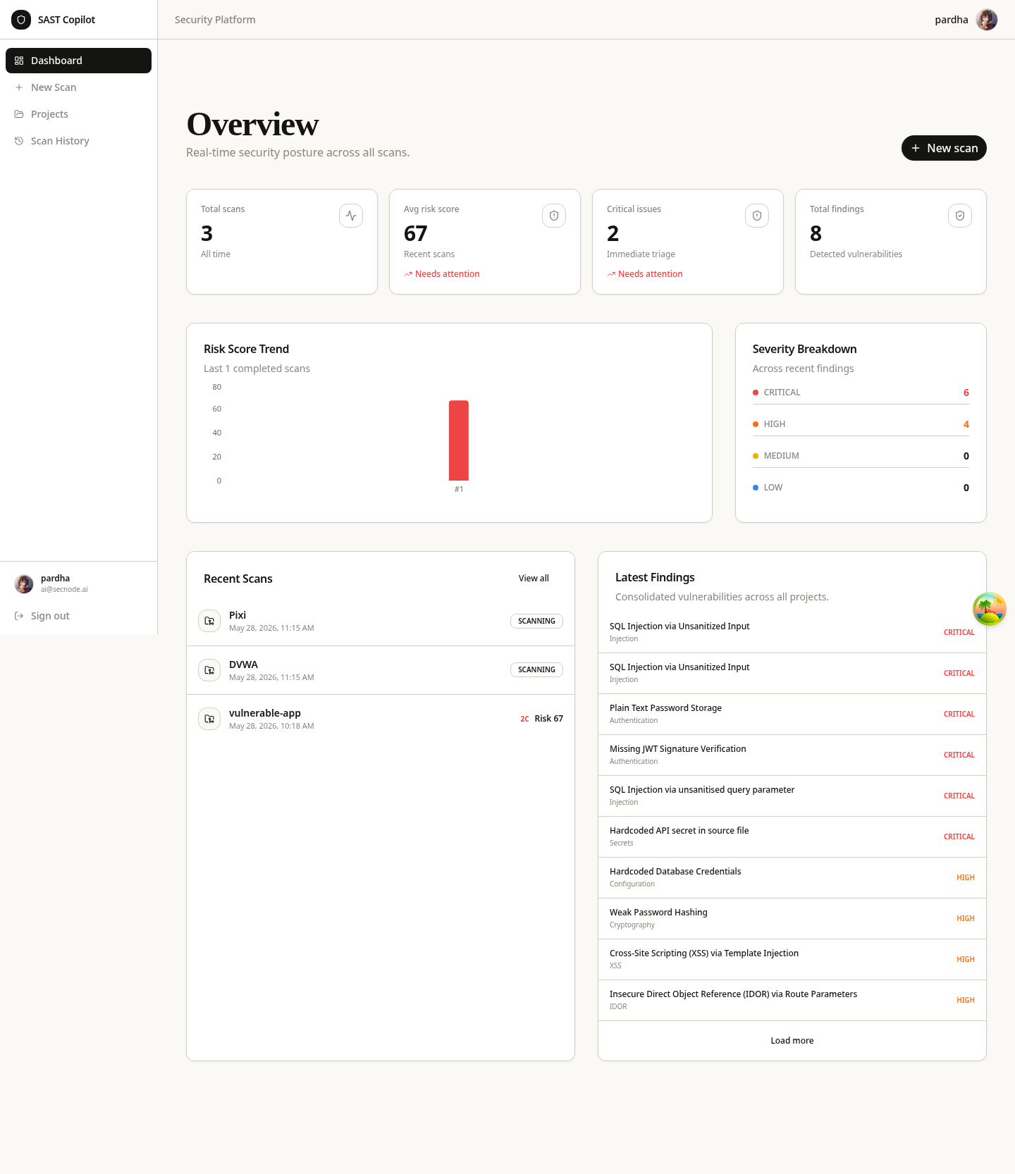
Results
Test Case 3 — Dashboard Overview
Action: open dashboard after scans complete.
Expected: risk score, severity breakdown, recent scans.
Result: metrics render with live data.
Result Screen

Slide 19
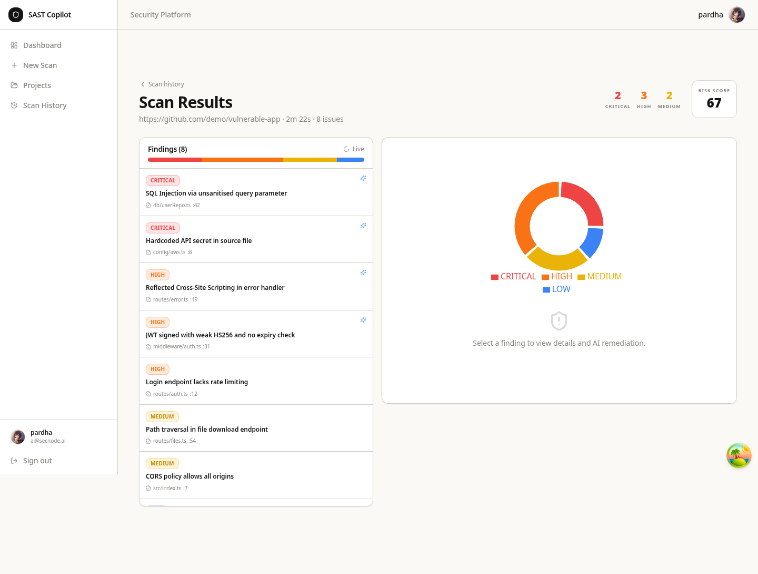
Results
Test Case 4 — Scan Results
Action: open a completed scan.
Expected: issue list, severity filters, AI Insight panel, code view.
Result: findings and AI remediation displayed.
Result Screen

Slide 20
Advantages
Explains and fixes issues, not just detects them.
Multi-provider fallback gives high availability even if one AI API fails.
Covers 11+ languages with no rule libraries to maintain.
Live streaming results and a weighted risk score for instant posture.
Developer-friendly; one-command Docker Compose deployment.

Slide 21
Conclusion
The AI Powered SAST Agent demonstrates LLM-native static analysis as a practical, transparent alternative to rule engines — uniting detection, explanation and remediation in one deployable platform.
Future Work
CI/CD pull-request scanning via a GitHub Action.
Automated fix pull requests using AI-generated patches.
SARIF export; fine-tuned local security model; precision/recall benchmarking; WebSocket push.

Slide 22
References
OWASP Foundation, "OWASP Top 10", 2021.
MITRE, "CWE Top 25 Most Dangerous Software Weaknesses", 2024.
B. Livshits and M. Lam, "Finding Security Vulnerabilities in Java Applications with Static Analysis", USENIX Security Symposium, 2005.
C. Tony et al., "LLMSecEval: A Dataset of NL Prompts for Security Evaluations", arXiv:2303.09384, 2023.
E. Yildirim et al., "ChatGPT vs. Static Analysis: Evaluating LLMs for OWASP API Security", arXiv:2412.09734, 2024.
Prisma, React, PostgreSQL, Docker and Express — official documentation, 2024.

Slide 23
THANK YOU

